Slide 1

Elastic Block Store (EBS)

Slide 2
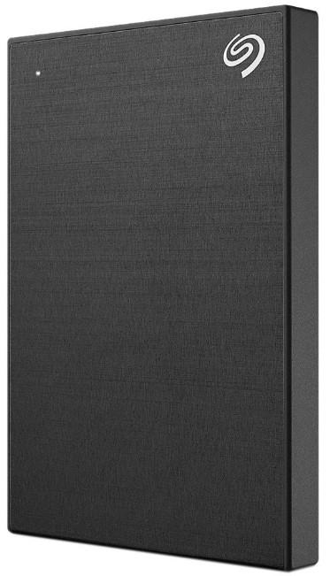

Simple Use-Case: External Hard Disk
External Hard Disk can be attached to the Workstation and detached whenever required (portable)
Depending on the use-case, you can buy external storage of different configuration based on size, performance and others.
Workstation

Slide 3


Understanding the Basics
Elastic Block Store (Amazon EBS) is a scalable, high-performance block-storage service designed for Amazon EC2.
These volumes can be attached and detached from EC2 instance.
Storage Volume
EC2 Instance

Slide 4
EBS is Network Storage
EBS volumes are attached to EC2 instance through Network.
There can be latency that might be involved.
1 volume attached
Network Mount
EC2 Instance
Elastic Block Store

Slide 5
Availability Zone Specific
You create an EBS volume in a specific Availability Zone, and then attach it to an instance in that same Availability Zone.
Cross Availability Zone based attachment is not supported.
1 volume attached
us-east-1a
us-east-1a

Slide 6
EC2 and EBS Attachment
One EC2 instance can be attached with multiple set of EBS volumes of different sizes.
10 GB
EC2 Instance
100 GB

Slide 7

EBS Snapshots

Slide 8

Understanding the Basics
You can back up the data on your Amazon EBS volumes to Amazon S3 by taking point-in-time snapshots.
You can create a new volume from the snapshot.
Snapshot
10 GB

Slide 9

Copying Snapshots
Snapshots can be copied across Availability Zone, Regions and AWS Accounts.
Copy Snapshot
AWS Account 1
AWS Account 2

Slide 10
Use-Case: Migrating Data Across Region
Attach
snapshot
copy & restore
us-east-1
Mumbai

Slide 11
Delete on Termination Attribute

Slide 12
Revising the Basics
Since EBS and EC2 are separate set of entities, they can live independently of each other.
10 GB
EC2 Instance
100 GB

Slide 13
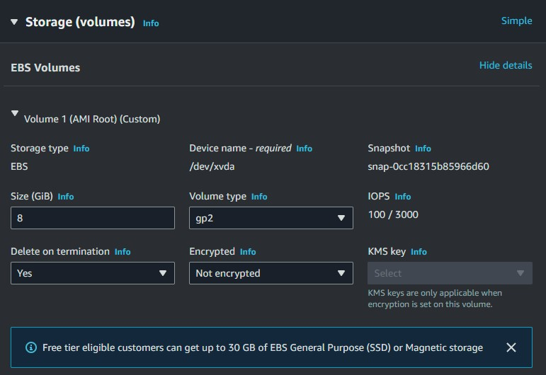
Basics of Deletion Attribute
When an instance terminates, the value of the DeleteOnTermination attribute for each attached EBS volume determines whether to preserve or delete the volume.

Slide 14
EBS Volume Types

Slide 15

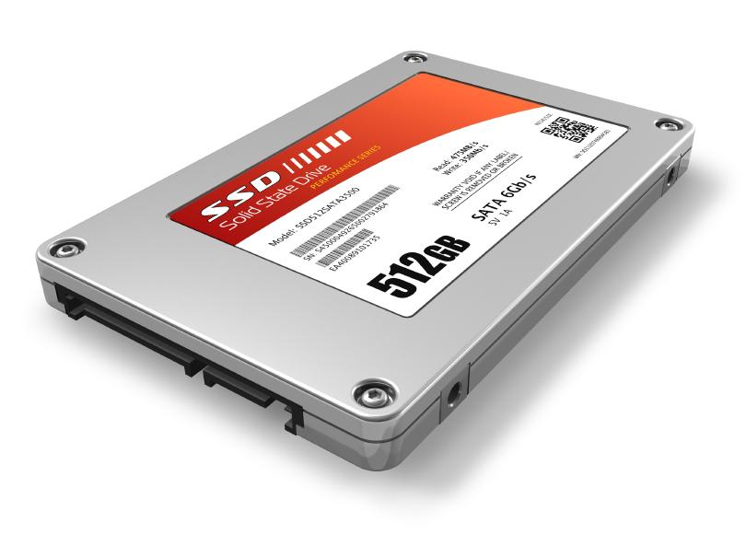
Performance Metrics in Storage Device
Storage Device is a piece of equipment on which information can be stored
Common disk performance metrics are :
Input / Output operations per second ( IOPS )
Throughput ( MB/s or MiB/s )

Slide 16
Basic Metrics Information
IOPS is a count of the read/write operations per second
Throughput is the actual measurement of read/write bits per second that are transferred over a network

Slide 17


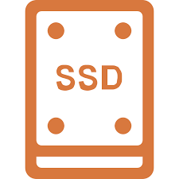
EBS Volume Types
EBS provides different volume types which differs in performance and price.
Hard Disk Drives
Solid State Drive

Slide 18
Solid State Drives (SSD)
Optimized for transactional workloads involving frequent read/write operations with small I/O size, where the dominant performance attribute is IOPS.
SSD-backed volume types include:
General Purpose SSD
Provisioned IOPS SSD

Slide 19
Hard Disk Drives (HDD)
Optimized for large streaming workloads where the dominant performance attribute is throughput.
HDD-backed volume types include:
Throughput Optimized HDD
Cold HDD Volumes

Slide 20
Previous Generation
Hard disk drives that you can use for workloads with small datasets where data is accessed infrequently and performance is not of primary importance.
Magnetic Volumes

Slide 21
General Purpose SSD
Characteristic | gp3 | gp2
Baseline IOPS | Baseline of 3000 IOPS | 3 IOPS/GiB (minimum 100 IOPS) to a maximum of 16,000 IOPS
Baseline Throughput | 125 MiB/s Maximum throughput = 1000 MiB/s | Throughput between 128 MiB/s and 250 MiB/s, depending on the volume size.
Generation | Newer | Older
gp3 offers SSD-performance at a 20% lower cost per GB than gp2 volumes.

Slide 22
Provisioned IOPS
Highest performance SSD volume designed for mission critical application workloads.
Characteristic | io2 Block Express | io2 | io1
Durability | 99.999% durability (0.001% annual failure rate) | 99.999% durability (0.001% annual failure rate) | 99.8% - 99.9% durability (0.1% - 0.2% annual failure rate)
Use cases | Workloads that require: Sub-millisecond latency More than 64,000 IOPS or 1,000 MiB/s of throughput | Workloads that require sustained IOPS performance or more than 16,000 IOPS | Workloads that require sustained IOPS performance or more than 16,000 IOPS
Max IOPS per volume | 256,000 | 64,000 † | 64,000 †
Max throughput per volume | 4,000 MiB/s | 1,000 MiB/s † | 1,000 MiB/s †

Slide 23
Hard Disk Drives
Characteristic | Throughput Optimized HDD | Cold HDD
Volume type | st1 | sc1
Max IOPS per volume | 500 | 250
Max throughput per volume | 500 MiB/s | 250 MiB/s
Use cases | Big data, Data Warehouse | Throughput-oriented storage for data that is infrequently accessed Scenarios where the lowest storage cost is important

Slide 24
Sample Question
Medium Corp is an E-Commerce organization and you have been assigned responsibility related to performance optimization of servers. They have a critical database server which receives lot of connections and they tried increasing RAM and CPU but still it is slow. What type of EBS volume type will you suggest ?
General Purpose SSD
Throughput Optimized
Provisioned IOPS
Cold HDD

Slide 25
EBS Encryption

Slide 26


Basics of Disk Level Encryption
Disk Level encryption involves encrypting all the files that are part of the storage device.
Multiple Set of Technologies: BitLocker, Apple FileVault and others
Decrypt password: 123
Client
Encrypted Storage

Slide 27
EBS Encryption
Amazon EBS encryption uses AWS KMS keys when creating encrypted volumes and snapshots.
For an encrypted EBS volume that is attached to a supported instance type, the following types of data are encrypted:
Data at rest inside the volume
All data moving between the volume and the instance
All snapshots created from the volume
All volumes created from those snapshots

Slide 28
Points to Note
Enabling EBS Encryption has minimal effect on latency.
Encryption and decryption are handled transparently, and they require no additional action from you or your applications.
Amazon EBS encrypts your volume using industry-standard AES-256 data encryption

Slide 29
Instance Store
Temporary Data

Slide 30

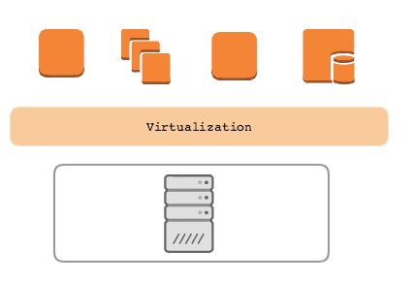



Revising EBS Architecture
In this type of architecture, the EBS volumes are mounted via the network to the EC2 instance.
When we stop and start the EC2, the VM might migrate to a different host altogether. Since EBS is mounted via the network, the challenge related to data does not arise.
Network
knowledge portal

Slide 31
What is Instance Store ?
AWS Instance Store provides temporary block storage volumes for use with EC2.
This storage is located on the disks that are physically attached to the host computer.
The size of instance store varies depending on your instance type.
knowledge portal

Slide 32

Important Points for Instance Store
Data in instance store is lost in the following situation:
The underlying disk drive fails.
The instance stops.
The instance terminates.
Instance store is included in the cost of EC2 instance, so they are quite cost-effective.
If planning to use instance store, make sure you backup your data to central storage places like S3.
knowledge portal

Slide 33
AWS Simple Storage Service (S3)
Unlimited Storage

Slide 34

Use Case - Storage Capacity
We all have some important data that needs to be reliably stored.
Most of us decides to store our data in external hard disk drives as a backup.
Important Folder
knowledge portal

Slide 35
Better Approach
In this approach, we decide to replicate the data in two different hard disk drives.
Downside:
Expensive Approach,
If you keep these disk in same location, there is a risk.
Important Folder
knowledge portal

Slide 36
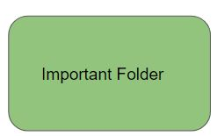
Best Approach
In this approach, we store the data in Cloud and let Cloud provider take care of backups.
Backups
Cloud Storage
Important Folder
knowledge portal

Slide 37


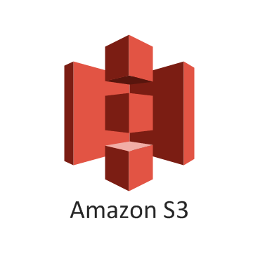
Cloud Storage Providers
There are multiple Cloud storage providers that are available.
Depending on your use-case, you can select one among them.
Cloud Storage

Slide 38
Introduction to S3
AWS Simple Storage Service (S3) is an object storage designed to store and retrieve any amount of data from anywhere
It is designed for 99.999999999% durability and 99.99% availability.
The aspect that makes AWS S3 so powerful are it’s associated features.
Versioning | Encryption | Logging
Transfer Acceleration | Cross Region Replication | Events
Requester Pays | Static Website Hosting | Tagging
knowledge portal

Slide 39
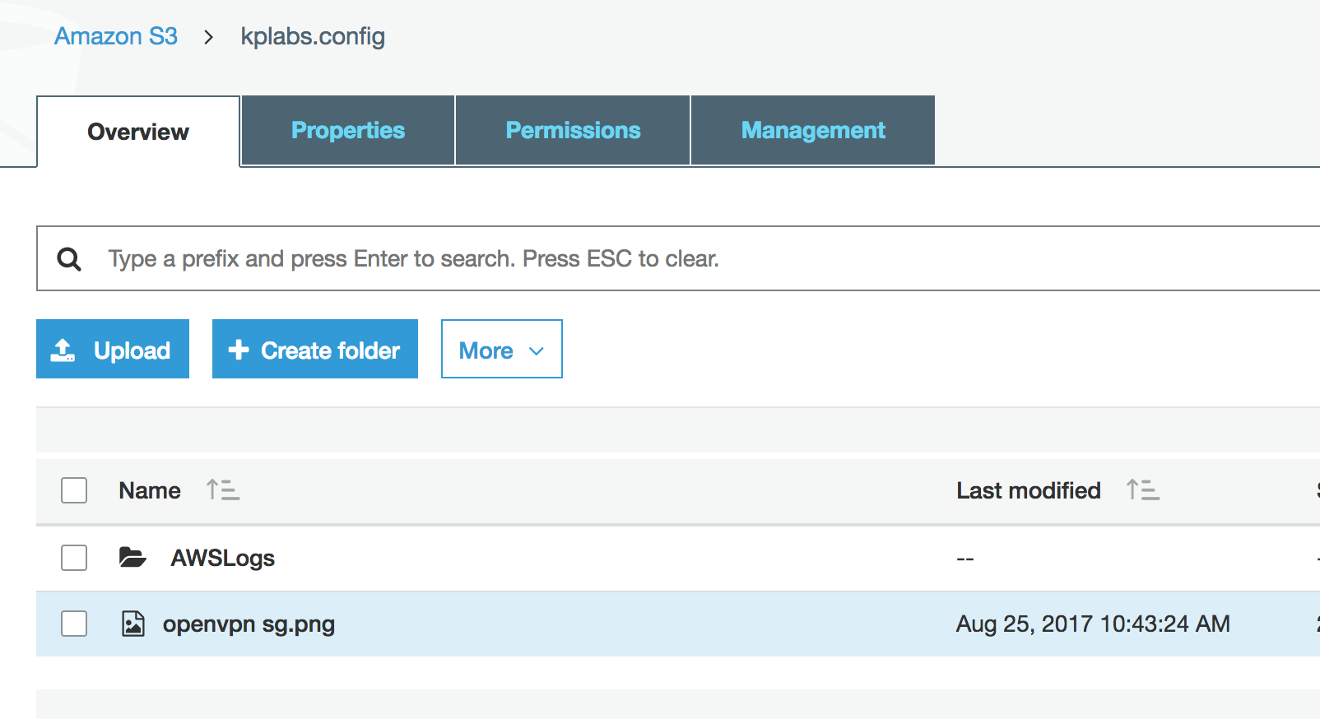
S3 Terminology
There are two important terminology in AWS S3 :
Buckets
Objects
Important Note: Bucket Names are unique across entire AWS Namespace.
knowledge portal

Slide 40
S3 Storage Classes
Cloud Storage is Saviour

Slide 41
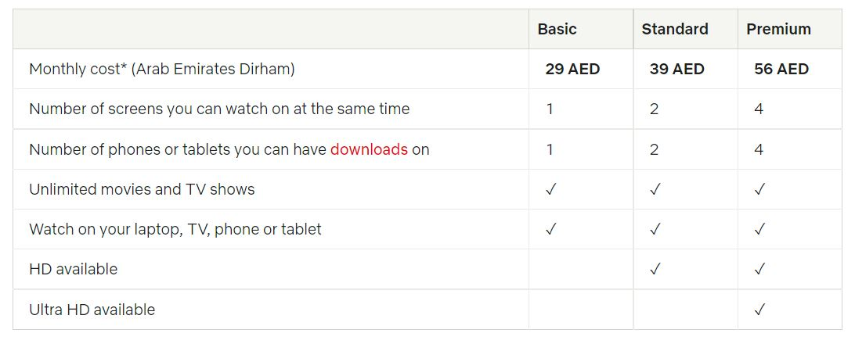

Use-Case - Netflix
Netflix offers various different subscription plans for various category of requirements.
Main Aim: Watch the Entertainment Content
knowledge portal

Slide 42
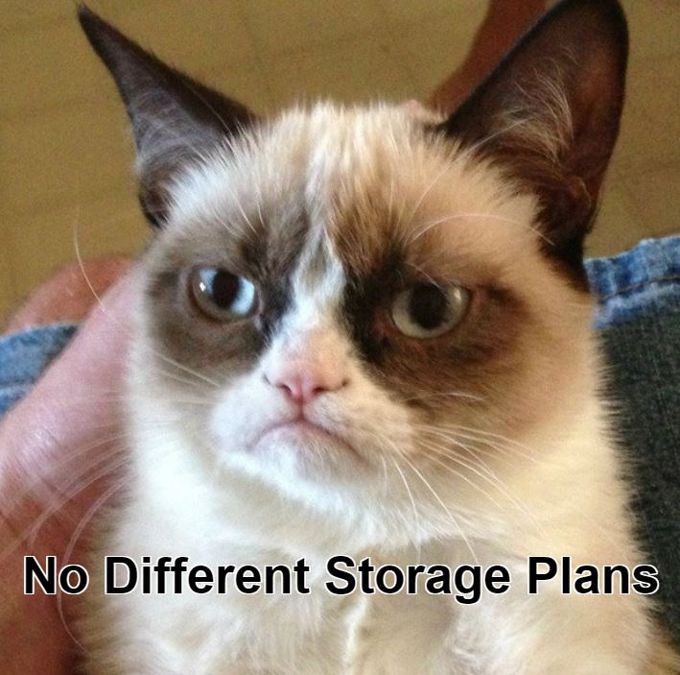
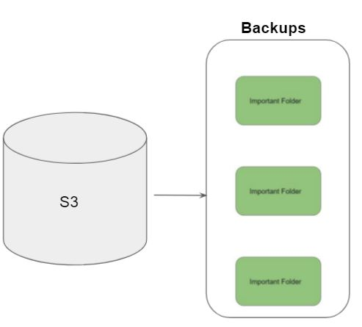
Initial Challenge - S3
AWS has millions of active customers.
Each customer might have different requirements for data storage.
Main Aim: Store Data.
knowledge portal

Slide 43
S3 Storage Classes
Amazon S3 offers a range of storage classes designed for different use cases.
Storage Classes | Description
S3 Standard | Offers high durability, availability, and performance object storage for frequently accessed data
S3 Standard-Infrequent Access | For data that is accessed less frequently, but requires rapid access when needed.
Amazon S3 Glacier | Low-cost storage class for data archiving
knowledge portal

Slide 44
AWS S3 Standard
S3 Standard offers high durability, availability, and performance object storage for frequently accessed data.
Designed for durability of 99.999999999% of objects ( eleven nines )
Example :-
If we have 10,000 files stored in S3 ( 11 nines durability ) then you can expect to lose one file every ten million years.
knowledge portal

Slide 45
AWS S3 Standard IA
S3 Standard-IA is for data that is accessed less frequently, but requires rapid access when needed.
Comparing storage cost of 1TB data stored in S3 based on accessibility patterns.
Criteria | Amazon S3 | Amazon S3 IA
Storage of 1TB Data | $23.44 | $23.50
50% storage accessed in last 30 days | - | $18.18
0% storage accessed in last 30 days | - | $12.80
knowledge portal

Slide 46
Amazon S3 Glacier
Glacier is meant to be for archiving and for storing long-term backups.
Ideally meant for data that needs to be archived for years without much requirement of access.
Criteria | Amazon S3 | Glacier
Storage of 1TB Data | $23.44 | $4.10
knowledge portal

Slide 47
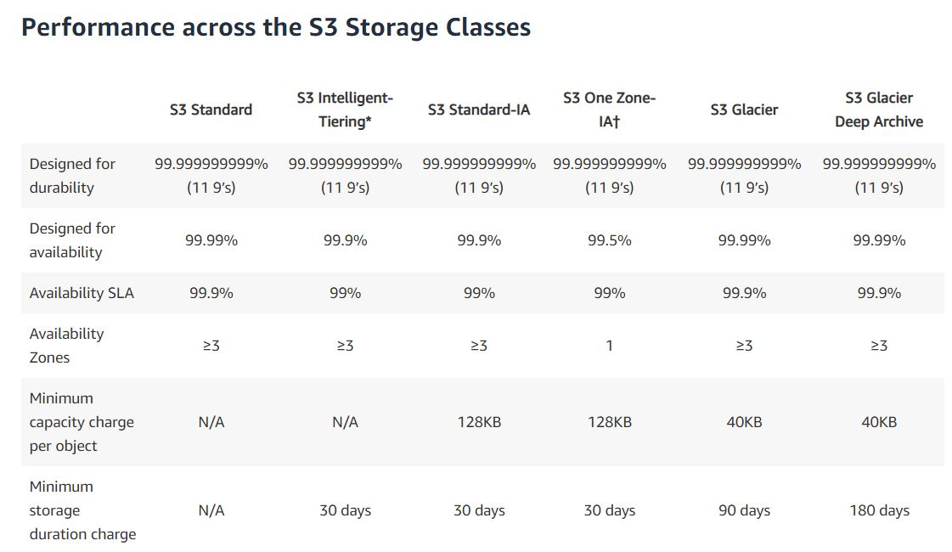
Multiple S3 Storage Classes

Slide 48
Durability vs Availability
Durability is percent ( % ) over one year period of time that the file which is stored in S3
will not be lost.
Availability is percent (%) over one year period of time that the file stored in S3 will
not be available.
Example :-
For Servers, Availability is one of the key metric and any minute of downtime is a loss.
However what happens if component of server itself fails and server goes down ?
knowledge portal

Slide 49
S3 Intelligent-Tiering
Smart Automated System

Slide 50
Overview of S3 Intelligent Tiering
The S3 Intelligent Tiering is primarily designed to optimize cost by automatically moving data to most cost-effective tier.
1TB of data stored in Standard S3 = $23.44
1TB of data stored in Standard IA = $12.80
Organization stores terabytes of data in S3.
It will be great if a solution automatically moves infrequent data to Standard IA.
knowledge portal

Slide 51
Overview of S3 Intelligent Tiering
The S3 Intelligent Tiering works by storing data in one of the two access tiers:
Frequent Access Tier (Costly)
Infrequent Access Tier (Much cheaper)
Frequent Access Tier
Infrequent Access Tier
knowledge portal

Slide 52
Overview of S3 Intelligent Tiering
The S3 Intelligent Tiering works by storing data in one of the two access tiers:
Frequent Access Tier (Costly)
Infrequent Access Tier (Much cheaper)
Frequent Access Tier
Infrequent Access Tier
knowledge portal

Slide 53
Overview of S3 Intelligent Tiering
Smart Automation System
Frequent Access Tier
Infrequent Access Tier
knowledge portal

Slide 54
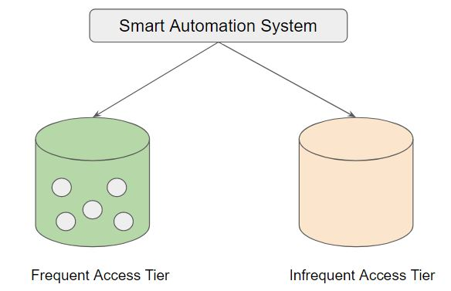
Revising S3 Intelligent Tiering
Amazon S3 monitors access patterns of the objects in S3 Intelligent-Tiering, and moves the ones that have not been accessed for 30 consecutive days to the infrequent access tier.
If an object in the infrequent access tier is accessed, it is automatically moved back to the frequent access tier.
A monthly monitoring and automation fee is charged at a per object level.
knowledge portal

Slide 55
S3 Storage Class - One Zone IA
Back again!

Slide 56
Understanding the Basics
Storage classes like Standard S3, Standard IA stores the data in minimum 3 availability zones.
Due to this, the overall cost per of storage is increased with such architecture.
Availability Zone 1
Availability Zone 2
Availability Zone 3
knowledge portal

Slide 57
Overview of One Zone IA
S3 One Zone-IA stores data in a single AZ and costs 20% less than S3 Standard-IA.
It’s a good choice for storing secondary backup copies of on-premises data or easily recreatable data.
Data will be lost in-case of availability zone destruction.
Availability Zone 1
knowledge portal

Slide 58
Pricing Comparison
Overview of Pricing comparison between storage classes:
1TB of data stored in Standard S3 = $23.44
1TB of data stored in Standard IA = $12.80
1 TB of data stored in One Zone IA = $10.24
knowledge portal

Slide 59
S3 Storage Class - Glacier
Back again!

Slide 60
Overview of Glacier
Amazon S3 Glacier is a low-cost, cloud-archive storage service that provides secure and durable storage for data archiving and online backup.
Storage Class
Glacier
Glacier Deep Archive
knowledge portal

Slide 61
Pricing Comparison
Storage Class & Data Storage | Pricing
1 TB Data stored in S3 Standard | $23.44
1 TB Data stored in One Zone IA | $12.80
1 TB Data stored in Glacier | $4.10
1 TB Data stored in Glacier Archive | $1.02
knowledge portal

Slide 62
Glacier vs Glacier Deep Archive
To keep costs low, Amazon S3 Glacier provides three options for access to archives, from a few minutes to several hours.
Glacier Deep Archive provides two access options, which range from 12 to 48 hours
Storage Class | Expedited | Standard | Bulk
Amazon S3 Glacier | 1–5 minutes | 3–5 hours | 5–12 hours
S3 Glacier Deep Archive | Not available | Within 12 hours | Within 48 hours
knowledge portal

Slide 63
Important Note
Amazon S3 Glacier for archiving data that might infrequently need to be restored from minutes to few hours.
S3 Glacier Deep Archive for archiving long-term backup cycle data that might infrequently need to be restored within 12 hours
knowledge portal

Slide 64
Static Website Hosting in S3
A Great Feature

Slide 65

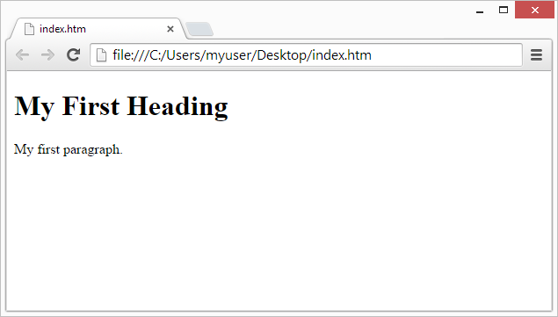


Challenges with Static Websites
If you want to host a basic static website, you need to create and manage the entire server infrastructure on a cloud provider.
EC2
SSM
Static Website
ELB
knowledge portal

Slide 66

Static Website Hosting in S3
With Amazon S3, you can now host static websites directly through S3.
S3 Bucket
Static Website
knowledge portal

Slide 67
Static Vs Dynamic Websites
On a static website, individual webpages include static content. They might also contain client-side scripts.
Dynamic website relies on server-side processing, including server-side scripts such as PHP, JSP, or ASP.NET.
knowledge portal

Slide 68
S3 Lifecycle Policies
S3 is Awesome

Slide 69
Overview of Lifecycle Policies
Organizations tends to keep terabytes of data in S3. For such cases, cost becomes a primary factor.
Storing the data directly into the AWS S3 Standard is not the best approach. Depending on the access patterns, criticality of the data, data should be transitioned to appropriate storage class.
We can store 1 months of logs in Amazon S3 Standard.
Move the logs older than 1 month to S3 Standard-IA
Move the logs older than 6 months to Glacier
knowledge portal

Slide 70


Transition Actions
After 30 days
After 60 days
video.mp4
video.mp4
video.mp4
S3 Standard-IA
Glacier
S3 Standard
knowledge portal

Slide 71
S3 Versioning
Versioning in Object Storage

Slide 72
Challenge 1 - Multiple Object with Same Key
Store File
a.txt
a.txt
a.txt
a.txt
Storage
knowledge portal

Slide 73

Challenge 2 - Accidental Deletion of Objects
Delete File
a.txt
Storage
knowledge portal

Slide 74
Versioning in Object Storage
Versioning allows users to keep multiple variants of an object in the same S3 bucket.
You can use versioning to preserve, retrieve, and restore every version of every object stored in your Amazon S3 bucket.
a.txt
a.txt
a.txt
a.txt
Storage
knowledge portal

Slide 75
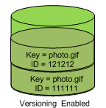
Important Pointers for Versioning
Once you version enable a bucket, it can never return to an unversioned state. You can, however, suspend versioning on that bucket.
The versioning state applies to all (never some) of the objects in that bucket.
knowledge portal

Slide 76
S3 Lifecycle Policies
S3 is Awesome

Slide 77
Overview of Lifecycle Policies
Organizations tends to keep terabytes of data in S3. For such cases, cost becomes a primary factor.
Storing the data directly into the AWS S3 Standard is not the best approach. Depending on the access patterns, criticality of the data, data should be transitioned to appropriate storage class.
We can store 1 months of logs in Amazon S3 Standard.
Move the logs older than 1 month to S3 Standard-IA
Move the logs older than 6 months to Glacier
knowledge portal

Slide 78
Transition Actions
After 30 days
After 60 days
video.mp4
video.mp4
video.mp4
S3 Standard-IA
Glacier
S3 Standard
knowledge portal

Slide 79
S3 - Cross Region Replication
Storage Service

Slide 80

Understanding the Use-Case
Many compliance has a requirement that the data must be replicated across greater distances.
Cross-Region Replication allows data from S3 buckets to be replicated across regions.
Replication
Mumbai
Singapore
knowledge portal

Slide 81
Important Pointers
Both source and destination buckets must have versioning enabled.
knowledge portal

Slide 82
Static Website Hosting in S3
A Great Feature

Slide 83
Challenges with Static Websites
If you want to host a basic static website, you need to create and manage the entire server infrastructure on a cloud provider.
EC2
SSM
Static Website
ELB
knowledge portal

Slide 84
Static Website Hosting in S3
With Amazon S3, you can now host static websites directly through S3.
S3 Bucket
Static Website
knowledge portal

Slide 85
Static Vs Dynamic Websites
On a static website, individual webpages include static content. They might also contain client-side scripts.
Dynamic website relies on server-side processing, including server-side scripts such as PHP, JSP, or ASP.NET.
knowledge portal

Slide 86
Multi-Part Upload
Saves our computer lives

Slide 87
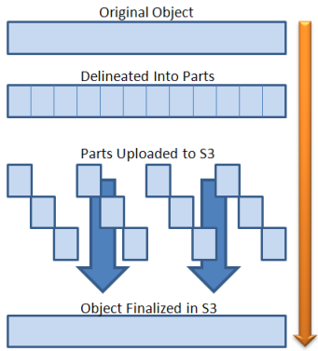
Understanding Multi-Part
Multi-Part upload is a way in which we upload an entire file in the form of small individual chunks to the storage device.
While uploading data via multi-part, we need to specify the part number and its position in the uploaded object. This will help AWS reconstruct data.
knowledge portal

Slide 88
Presigned URLs
S3 is Awesome

Slide 89

Use Case of Music Company
Company ABC is an online Music selling company. Once the user purchases a song, he should be able to download the song. Your company has decided to store all of its song data in S3 due to its highly durable option.
How will you go ahead with this scenario?
r
knowledge portal

Slide 90

Understand in Graphical Way
Download Song A
Music S3 Bucket
John
knowledge portal

Slide 91
Understanding Presigned URL
All objects in S3 are ‘Private’ by default.
However Object owner can optionally share objects with others by creating a pre-signed URL to grant time-limited permission to download the object.
Achieving the Use Case :-
After a user purchases a song and requests to Download, the application should generate a pre-signed URL that will allow the ‘MP3’ file stored in S3 to be downloaded by the user.
knowledge portal

Slide 92
S3 Object Lock
Mastering S3

Slide 93

Overview of WORM
Write once read many (WORM) describes a data storage device in which information, once written, cannot be modified.
This write protection affords the assurance that the data cannot be tampered with once it is written to the device.
Modify / Delete
Storage
knowledge portal

Slide 94

Use-Case - Ransomware
Ransomware also blackmail trojans , blackmail software are malicious programs with the help of which an intruder can prevent the computer owner from accessing data, its use or the entire computer system.
Private data on the foreign computer is encrypted or access to it is prevented in order to demand a ransom for decryption or release.

Slide 95
S3 Object Lock
With S3 Object Lock, you can store objects using a write-once-read-many (WORM) model.
You can use it to prevent an object from being deleted or overwritten for a fixed amount of time or indefinitely.
Modify
S3
knowledge portal

Slide 96
Retention Modes
Retention Mode | Description
Governance Mode | When deployed in Governance mode, AWS accounts with specific IAM permissions are able to remove object locks from objects.
Compliance Mode | In Compliance Mode, the protection cannot be removed by any user, including the root account.
knowledge portal

Slide 97
S3 Requester Pays
Back to Billing!

Slide 98


Understanding the Challenge
In general, bucket owners pay for all Amazon S3 storage and data transfer costs associated with their bucket.
Request to Download 1 TB file
Access granted, here you go.
knowledge portal

Slide 99
After Requester Pays
With Requester Pays buckets, the requester instead of the bucket owner pays the cost of the request and the data download from the bucket.
The bucket owner always pays the cost of storing data.
Request to Download 1 TB file
Access granted, here you go.
But your AWS account will pay for it.

Slide 100
Storage Gateway
Hybrid Storage

Slide 101
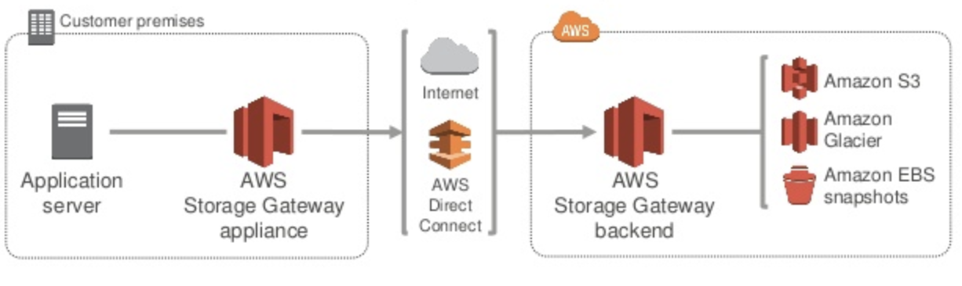
Introduction
AWS Storage Gateway is a hybrid storage service that allows the on-premise application to easily use the cloud storage
knowledge portal

Slide 102
Storage Gateway
Storage Gateway appliance uses standard storage protocols like NFS, iSCSI which the application connects to and stores the data.
The other end of storage gateway connects to AWS storage services like S3, Glacier and EBS Snapshots
knowledge portal

Slide 103
Storage Gateway Configuration
There are three different configuration available :
Gateway Stored Volume
Gateway Cached Volume
Gateway-virtual tape library
knowledge portal

Slide 104
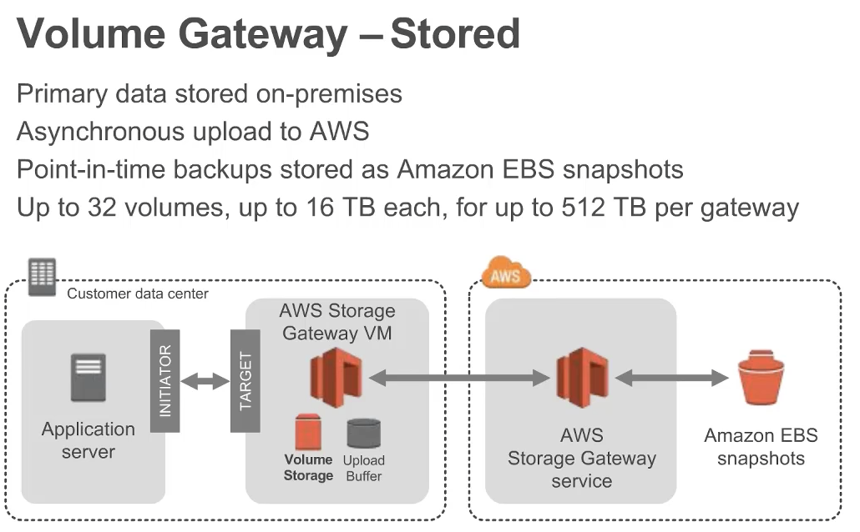
Gateway Stored Volumes
Gateway Stored Volume :
Stores primary data locally while asynchronously backing up data to AWS.
knowledge portal

Slide 105
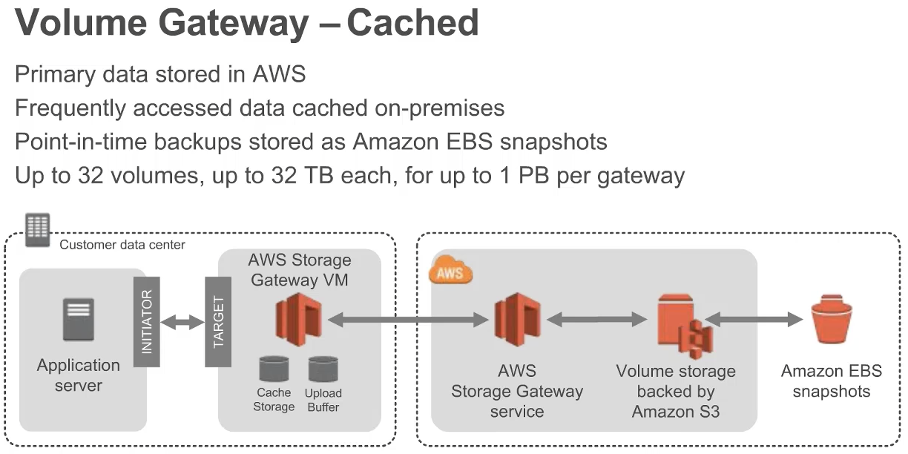
Gateway Cached Volumes
Gateway Stored Volume :
Data is stored primarily on AWS S3 with cache of recently read or written data stored locally in the on-premise server.
knowledge portal

Slide 106
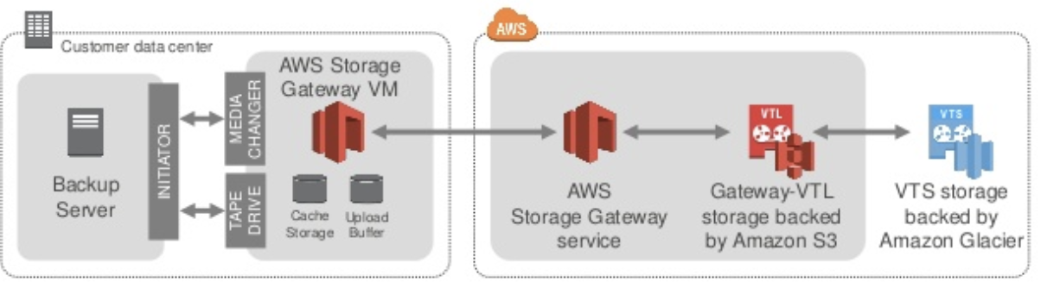
Gateway-virtual tape library
Gateway-virtual tape library
Virtual tapes stored in S3 with frequently accessed data stored on-premise.
knowledge portal

Slide 107
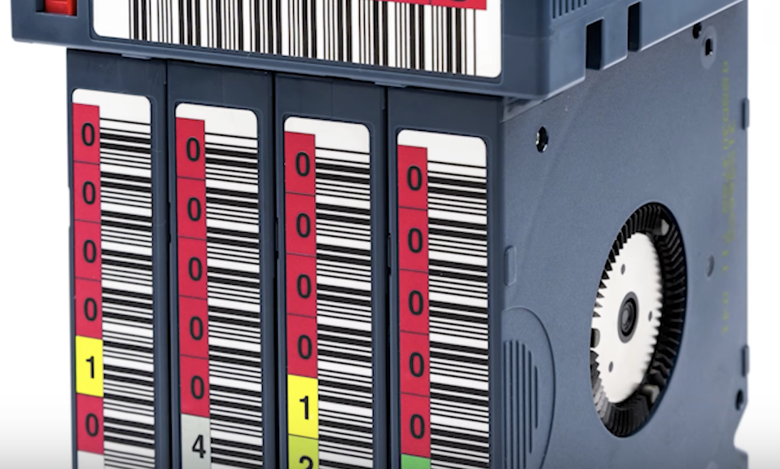

Tape based storage
Tape backup is practice of periodically copying data from primary storage device to a tape cartridge so data can be recovered if there is any data crash or failure on primary device.
Tape solutions remains most cost effective solution till date.
knowledge portal

Slide 108
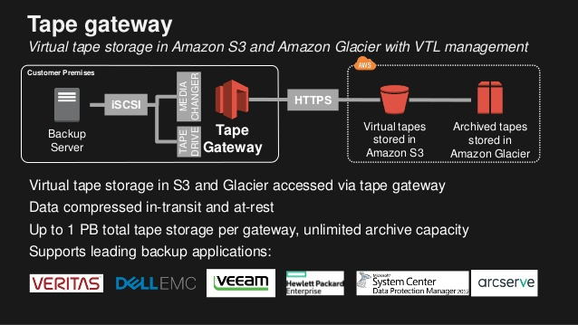
VTS and VTL
knowledge portal

Slide 109
Amazon FSx
Storage Service

Slide 110


Overview of FSx
Amazon FSx provides highly cost effective, fully managed, shared cloud file storage for Windows and Linux applications.
Mounted
knowledge portal

Slide 111
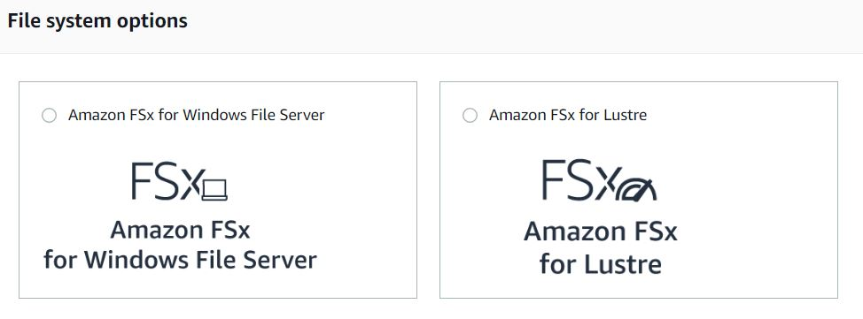
File System Options
Depending on the operating system, there are multiple file-system options that are available.
knowledge portal

Slide 112
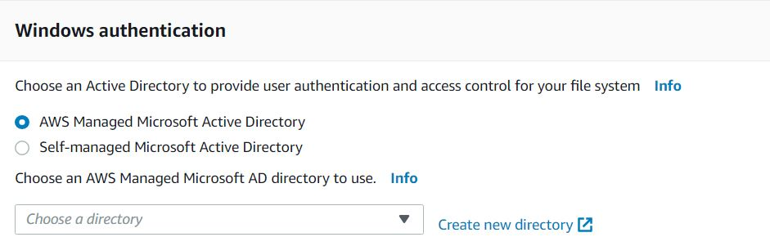
Amazon FSx for Windows
Amazon FSx for Windows File Server provides fully managed file storage that is accessible over the industry-standard Server Message Block (SMB) protocol.
Built on Windows Server, Amazon FSx delivers a wide range of administrative features such as data deduplication, end-user file restore, and Microsoft Active Directory (AD) integration.
knowledge portal

Slide 113

Amazon FSx for Linux
Amazon FSx for Lustre makes it easy and cost effective to launch and run the world’s most popular high-performance file system
Allows your workloads to process data with consistent sub-millisecond latencies, up to hundreds of gigabytes per second of throughput, and up to millions of IOPS.
knowledge portal

Slide 114
Amazon Elastic File System (EFS)
Network Attached Storage

Slide 115


Overview of Elastic File System
Amazon Elastic File System (Amazon EFS) provides a simple, serverless, set-and-forget elastic file system for use with AWS Cloud services and on-premises resources.
It is built to scale on demand to petabytes without disrupting applications, growing and shrinking automatically as you add and remove files
Mount
Elastic File System
EC2
knowledge portal

Slide 116



Attachment to Multiple Targets
Multiple compute instances, including Amazon EC2, Amazon ECS, and AWS Lambda, can access an Amazon EFS file system at the same time, providing a common data source for workloads.
Elastic File System
knowledge portal

Slide 117
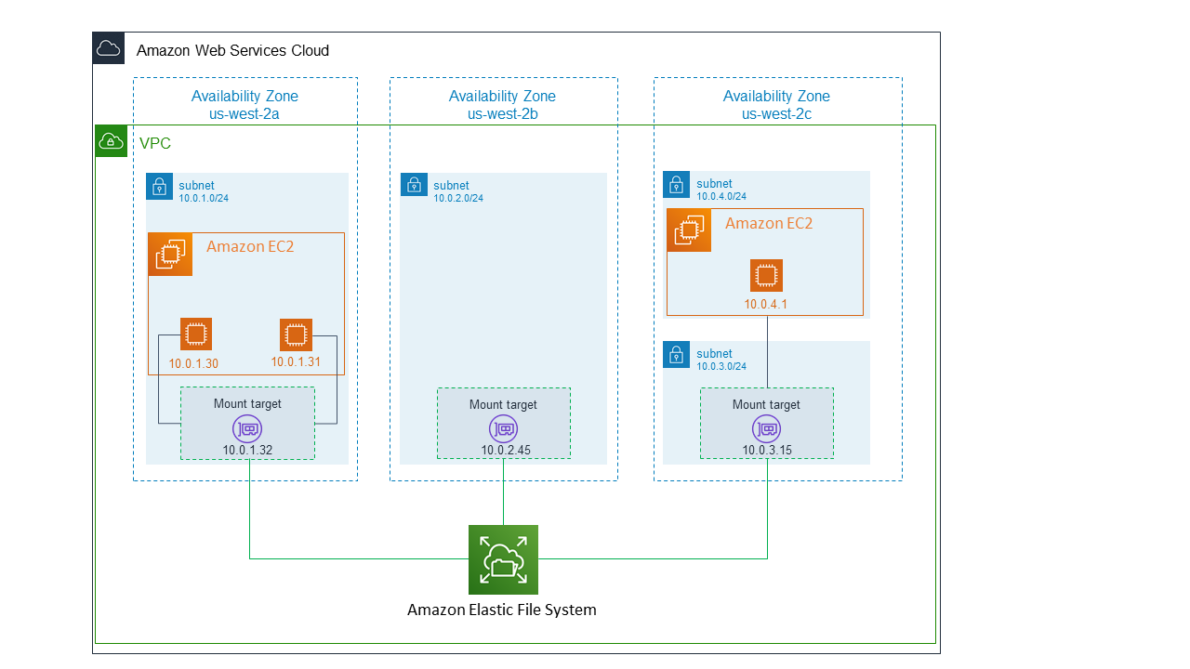
Understanding EFS Architecture
To access file system from instance inside the VPC, we need to create mount target in the VPC.
knowledge portal

Slide 118



Network File System
Network File System (NFS) is a networking protocol for distributed file sharing.
EFS uses the Network File System version 4 (NFS v4) protocol
Mount
Client
NFS Server
knowledge portal

Slide 119
Pricing Considerations
AWS EFS is expensive when compared to other storage options like EBS, S3.
Consideration | Pricing
1 TB EFS with 80% frequently accessed data | $250
1TB EBS Storage | $102
1 TB of S3 Storage | $24
knowledge portal

Slide 120
Important Pointers
If performance is your concern, always prefer EBS.
EFS can even be accessed from on-premise datacenter using an AWS Direct Connect or AWS VPN connection.
With Amazon EFS, you pay only for what you use per month.
knowledge portal

Slide 121

AWS Snowball Family

Slide 122
Understanding with Use-Case
Organization A has hosted all of it’s storage infrastructure in data-center.
Total Storage: 500 TB.
They have now decided to use S3 due to the benefits that it provides.
Bandwidth | Transfer Time
100 Mbps | 510 days.
500 Mbps | 101 days
1 Gbps | 50 days

Slide 123

AWS Snowball Family
Allows customers to Accelerate moving offline data or remote storage to the cloud
Send Storage Device
Customer
AWS Internal Network
AWS Team
Ship Back Device

Slide 124
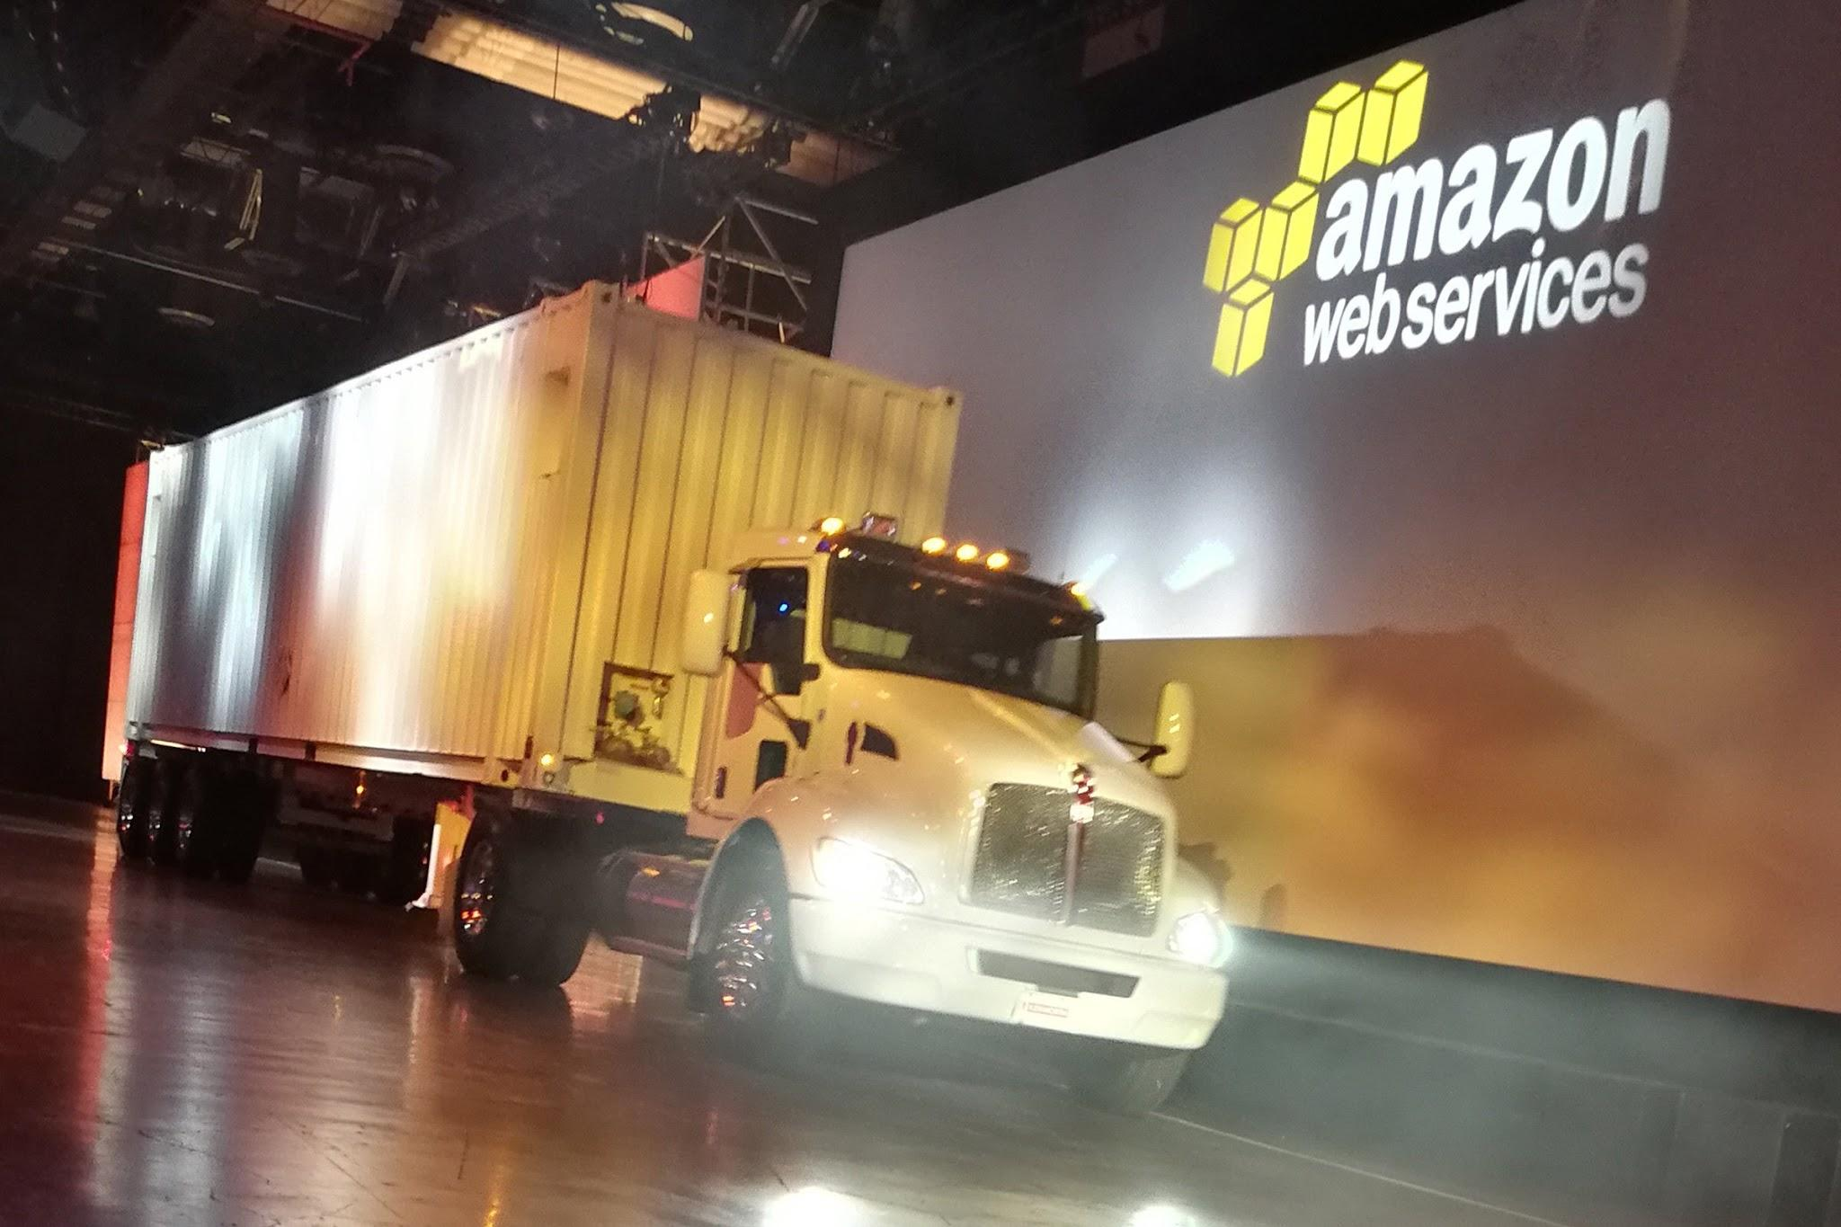
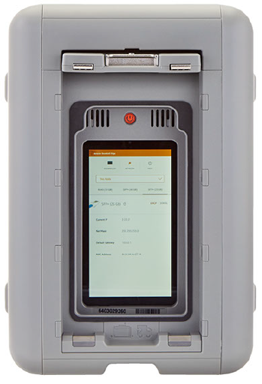
How the Storage Devices Look
Snowball Edge
Snowmobile

Slide 125
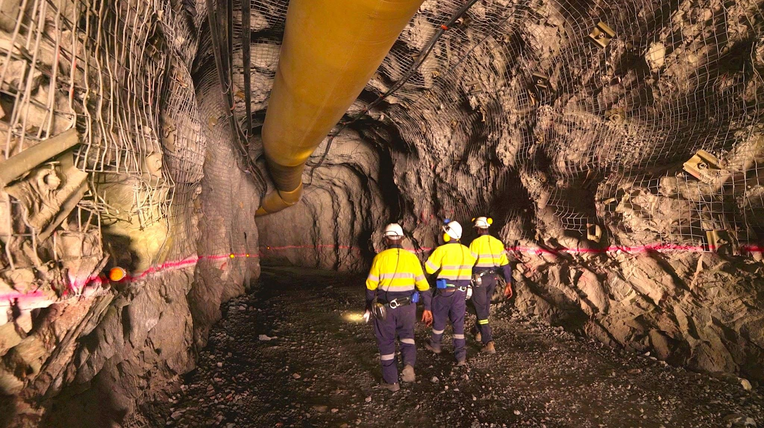

Edge Computing Functionality
These devices can also come with edge computing capabilities.
This means, you can run your applications in EC2 instances in the devices so that you can work in edge environments with limited connectivity.
Process data locally (Image/ Video Processing, Machine Learning etc)

Slide 126

Snowcone
AWS Snowcone is a small, rugged, and secure device offering edge computing, data storage, and data transfer on-the-go, in severe environment with little or no connectivity.
Can carry in backpack, drones and others.
8 TB of usable storage

Slide 127
Snowball Edge
AWS Snowball Edge is a type of Snowball device with on-board storage and compute power for select AWS capabilities
Available in Multiple Storage Capacity like 100 TB, 40 TB and others.

Slide 128
Snowball Edge
Device | Description
Snowball Edge Storage Optimized (for data transfer) | This option has a 100 TB (80 TB usable) storage capacity.
Snowball Edge Storage Optimized (with EC2 compute functionality) | This option has up to 80 TB of usable storage space, 24 vCPUs, and 80 GB of memory for compute functionality
Snowball Edge Compute Optimized | Most compute functionality, with 104 vCPUs, 416 GB of memory, and 28 TB of dedicated NVMe SSD for compute instances.
Snowball Edge Compute Optimized with GPU | Identical to the Compute Optimized option, except for an installed GPU

Slide 129
AWS Snowmobile
AWS Snowmobile moves extremely large amounts of data to AWS.
Transfer up to 100 PB per Snowmobile, a 45-foot-long ruggedized shipping container pulled by a semi-trailer truck.

Slide 130
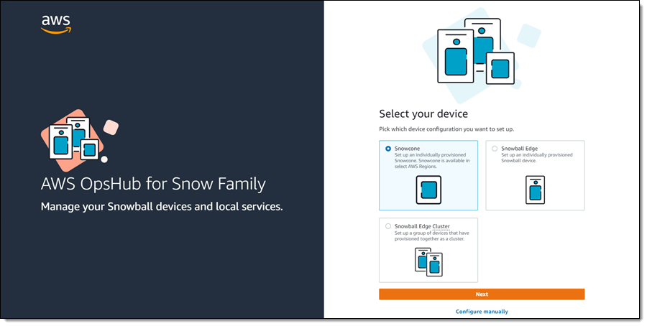
AWS OpsHub
AWS OpsHub is a graphical user interface you can use to manage your AWS Snowball devices.

Slide 131

AWS Backup

Slide 132





Understanding with Use-Case
AWS has lots of services where data can be stored.
For production environment, data backup is one of the critical task.
Taking backup at individual service level can take lot of time and require customization.
RDS
DynamoDB
S3
EFS

Slide 133
Introducing AWS Backup
AWS Backup is a fully-managed service that allows customers to configure backup policies in one central place.
AWS Backup
Backup
Backup
RDS
DynamoDB
S3
EFS

Slide 134
Benefits of using AWS Backup
Easily create backup rules for daily, monthly backups.
Backup Process is automated at a scheduled time.
Supports Cross-Region, Cross-Account Backups.
AWS Backup can back up on-premises Storage Gateway volumes and VMware virtual machines
Supports Retention Period that tells how long to store backup.

Slide 135


Join us in our Adventure
kplabs.in/twitter
Be Awesome
kplabs.in/linkedin

